Slide 1
DIGITAL PORTFOLIO
Student name: S.J.DEEPAKVASAN
Register no and nm id: 24h342/44969FA33E4DDC9B5CB43AE18D187F89
Department: BCA
COLLEGE (COLLEGE/UNIVERSITY):AM JAIN COLLEGE

Slide 2
Agenda
Problem statement
Project overview
End users
Tool and Technological
Portfolio design and layout
Features and functionality
Result and screenshot
Conclusion
GitHub link

Slide 3
Problem statement:
Many students lack a simple, professional way to showcase
Their skills, project, and certificate in one place

Slide 4
Project overview:
This project is a personal portfolio website built with Html, CSS.
It provides details about education, skills, certificate, and contact information

Slide 5
End users:
Recruiters
Hiring manager
College faculty
Peers & tech community

Slide 6
Tool and technological
HTML
CSS
JavaScript
Email form
Hosting platform link GitHub page/ netify

Slide 7
Portfolio design & layout:
Clean And modern ui
Navigation bar With smooth access
Section: about, skills, Certificate, contact
Response Grid layout for skills And certificate

Slide 8
Features & functionality:
Personal information Section
Skills and certificate Showcase
Contact form (Mail Integration)
Response design

Slide 9
Result & screenshot:
The portfolio successfully Demonstrates skills, Certificate,
And personal branding
Screenshots Of webpage Can be inserted here.

Slide 10
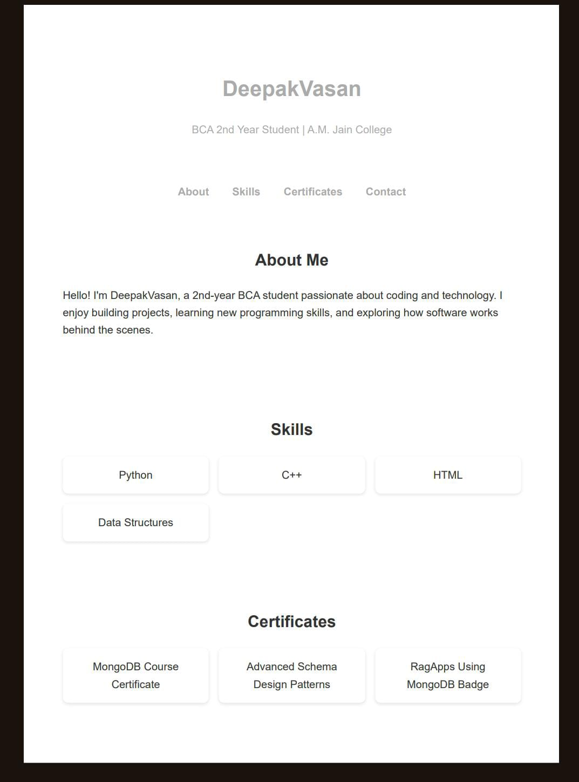
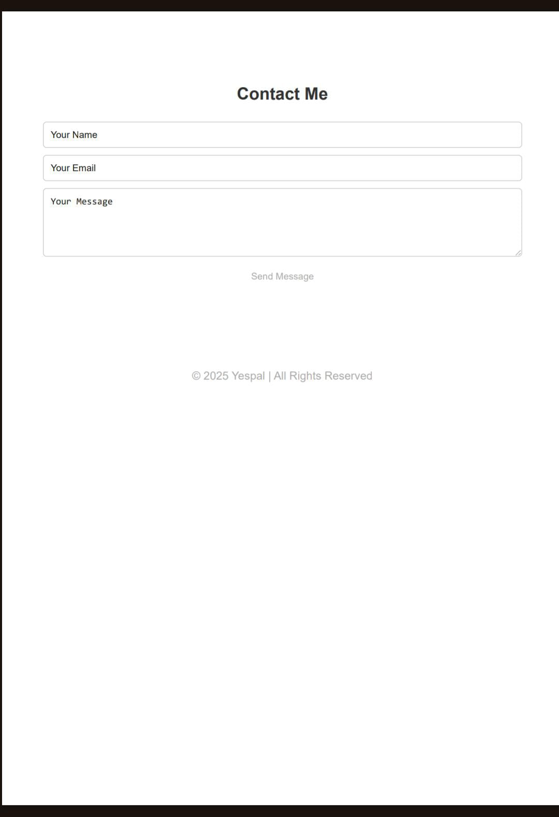
Output of portfolio
output
.

Slide 11
Conclusion:
The portfolio Help in Personal Branding And career opportunities . It’s
act as a digital Resume and showcase Of skills

Slide 12
GitHub link :
GitHub repository:Github profilehttps://github.com/24h342-sudo/myserver.git

